Slide 1


CS 637 Final Presentation
E- Discount
Name:- Gaurav Dabli, Harshita Gupta, Naresh Donthula, Sachin Rungta, Si Chen, Young Zhuang (Team Lead)

Slide 2
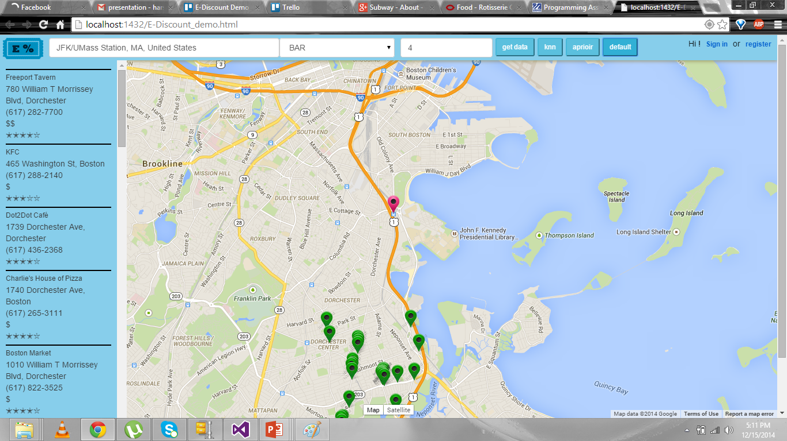
Functionality

Slide 3
Technologies and Tools Used
SQL
LINQ
JSON
JQUERY
AJAX
CSS
HTML
Artificial Intelligence
ASP.NET
Google Map

Slide 4

SQL- Database and stored procedures.
LINQ- connecting database to business layer used(object oriented design)
JSON- connecting business layer to presentation layer.
JQUERY- Used to realize AJAX.
CSS- Style sheets
HTML- Content Management

Slide 5
Major Challenges
Data Mining - Implementing APRORI and KNN algorithms

Slide 6
Users login
Sign in
Register as the user for the website
Registering as the Business Account

Slide 7
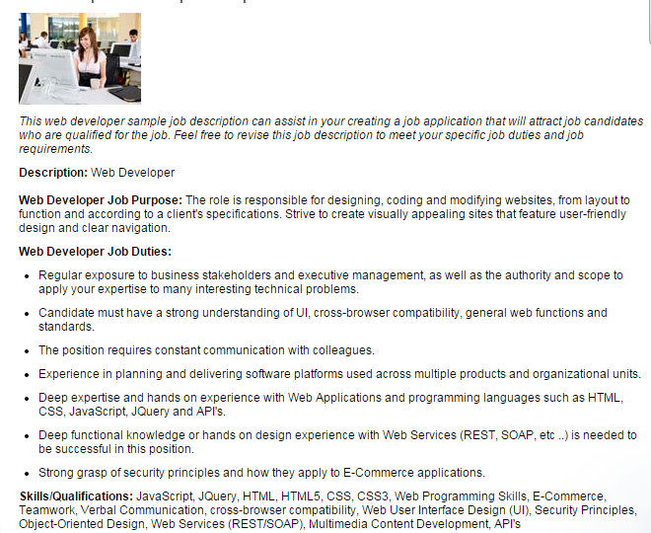

Slide 8
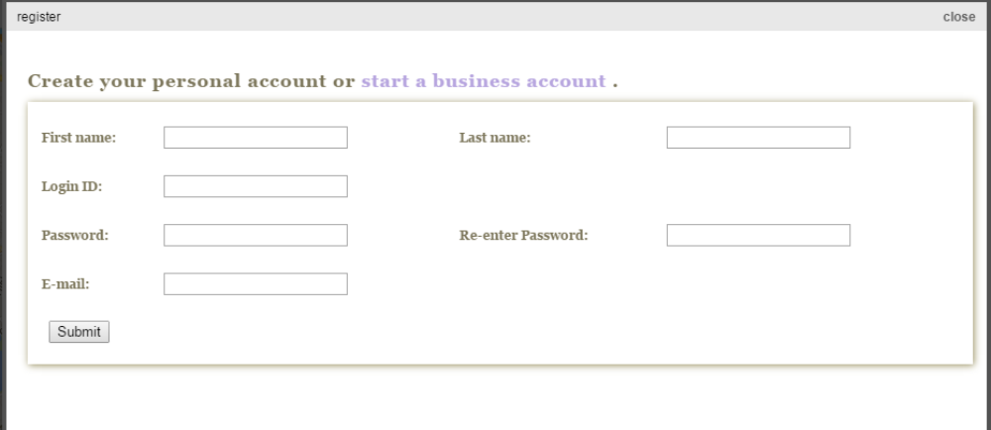
Registration as the user

Slide 9
Registration for the business account
Track Location
Tell us about your business
Using Google API
Contact information
Business Type
Price
State
Name
Free
Zip code
Login id
Clubs
Moderate
Country
Password
Restaurants
Very Expensive
Website
Bars
Expensive
City
Email
Street Address
Inexpensive
Hotels
Description
Phone

Slide 10
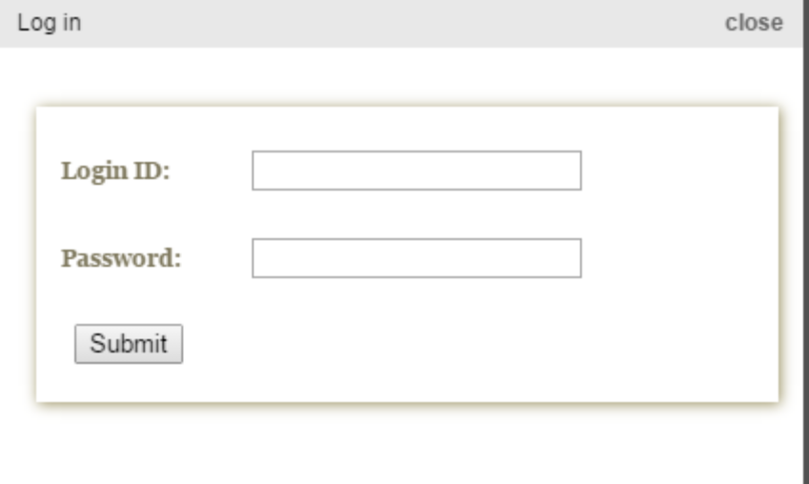
Sign in

Slide 11
Discount
In our website, dynamic entries is also available.
That means, Owners of the restaurants can also publish discounts.
In this, the owner can fill all the details relevant to the discount in the form provided in the website.
All the attributes are shown in the database table. The discount is saved in database table.
When the user visits the restaurants this new entered discount is available for them.

Slide 12
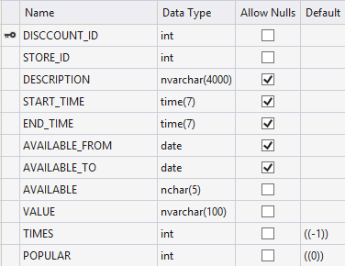
Discount Db Table

Slide 13
Feedback
In feedback section, we are taking feedback from the users and providing it to future users.
In the Presentation tier, the user creates a feedback in the provided form.
The business tier, provides Feedback provider which store the feedback received from presentation tier.
The feedback is saved with the username. So, as to show the user that this is a valid feedback.

Slide 14
Feedback
Presentation Tier
Feedback Form
Create Feedback
Json
Json
Feedback Provider
Business Tier
LinQ
LinQ
Feedback
Database Tier
Insert Feedback

Slide 15
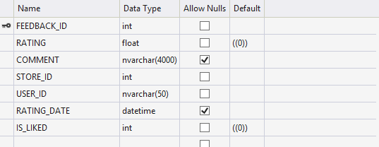
Feedback Db Table

Slide 16
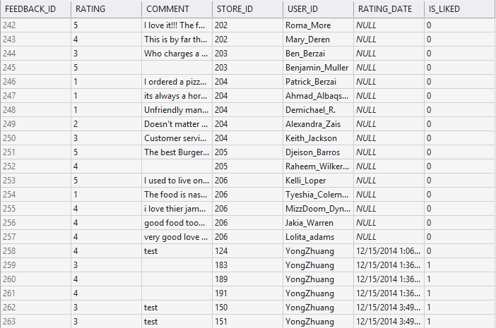
Feedback Data

Slide 17
Recommendation
Recommendation is the advising given to already logged in user.
When the user visits bar, restaurants, cafes frequently then in the back end i.e., in database the counts of the user id i.e., id with the category =id i.e. cid is increased. Whenever the user selects the category the counts increments itself with 1.
Hence, when the user visits, the site the category with the maximum count is displayed in the recommendation section.

Slide 18
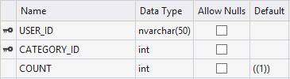
Recommendation DB Table
Recommendation is just one phase of our AI implementation.

Slide 19
Classification (kNN)
kNN: k-Nearest Neighbors
Goal: classify the test object by its close neighbors
Predict whether a particular user will like or unlike a restaurant based on his/her previous behavior (like or unlike other restaurants in a certain distance from the input/current position, given rating and price level).

Slide 20
Collecting data
When a return user is trying to search restaurants in a certain distance from the input/current position, we combine the data from the Store table and the Feedback table.
For this user, we will obtain the data similar as:
STORE_ID | RATING | PRICE_LEVEL | IS_LIKED
124 | 4.0999999046325684 | 2 | 1
126 | 0 | 1 | 0
127 | 0 | 1 | 0
128 | 4.5 | 0 | 1
129 | 4.0999999046325684 | 2 | 1
130 | 4.3000001907348633 | 0 | ?
training set
test set

Slide 21
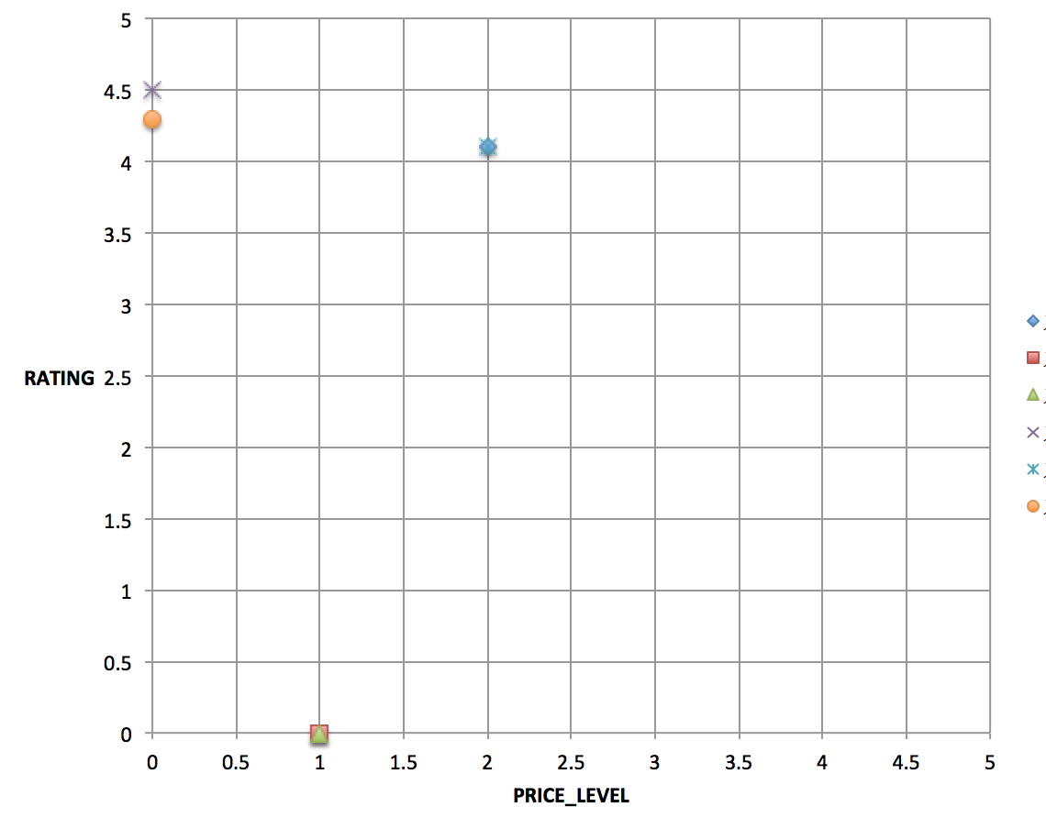

Analysis and Prediction
2-dimensional coordinate system:
d(p-p_{i})= ((p_PRICE_LEVEL – p_{i}_PRICE_LEVEL)^2 + (p_RATING- p_{i}_RATING)^2)^(1/2)
d
p
1.Calculate the distance d between point p(STORED_ID = 130) and each p_{i}
2.Use d to obtain weight factor w_{i} (the nearest neighbors may vary widely in their distance)
p_{i}
STORE_ID
124 (1)
126 (0)
127 (0)
128 (1)
129 (1)
130 (?)
where z is the test object,
y ∈ D, the set of training objects

Slide 22
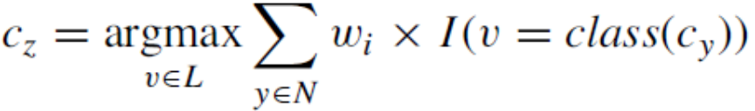
Analysis and Prediction
STORE_ID | distance | weight | ∑ wi × I | IS_LIKE
130 |  |  |  | ?
128 | 0.199999809 | 25.00004768 | 25.49509717 | 1
124 | 2.009975153 | 0.247524745 |  | 1
129 | 2.009975153 | 0.247524745 |  | 1
126 | 4.414748197 | 0.051308359 | 0.102616718 | 0
127 | 4.414748197 | 0.051308359 |  | 0
c_{z} ∈L, where L is the set of classes used to label the objects
N ⊆ D, the set (neighborhood) of k closest training objects for z
I(•), indicator function that returns 1 if its argument is true and 0 otherwise
Result: k5 = 1, where k = number of stores rated (like/unlike) by the user in a certain distance

Slide 23
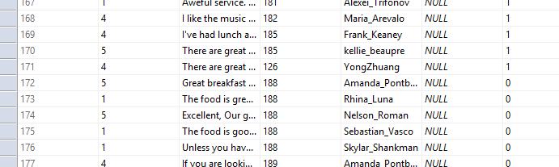
Association Mining – Apriori (AI) collecting Database & comparing it
Def : Artificial intelligence views as thinking and acting humanly.
Suggesting the Current User by giving best Results obtained from Database of all website users who shown Similar interests as current User did. This Gives our website to think Regularly like a human, how the users are and what they really need and to giving updated suggestions.
Once, user visits any restaurant/store and gives feedback as like in our website, that will be added to his database.
var userlike = new List<int>() { 3, 5 };
var trainingDS = new List<List<int>>()
var keyfrequency = new List<KeyFrequency>()
var youlike = new List<int>(){3,5};
(from s in nearbyStores
join f in mydb.FEEDBACKs on s.STORE_ID equals f.STORE_ID
where f.IS_LIKED == 1 && f.USER_ID==userid
select f.STORE_ID).Distinct();

Slide 24
I Implementation with example.
U1 | R1 | R2 | R3 | R7 | R10
U2 | R1 | R4 | R5
U3 | R3 | R7 | R9 | R1
U4 | R1 | R2 | R3 | R4 | R5
U5 | R1 | R5
U6 | R9 | R1 | R3
U7 | R5 | R6 | R8
 | >=2
R1 | 6
R2 | 2
R3 | 4
R4 | 2
R5 | 3
R6 | 1
R7 | 2
R8 | 1
R9 | 2
R10 | 1
Minimum Support Count = 2
can be varied
R1 | R2
R1 | R3
R1 | R4
R1 | R5
R1 | R7
R2 | R3
R3 | R7
R4 | R5
R1 | R2 | R3
R1 | R3 | R7
R1 | R4 | R5
Traning data set
Frequency list
If current user is U5(R1,R5) he is suggested by R4.
U7(R5,R6,R8) he is suggested by R1 but not R1 and R4.

Slide 25
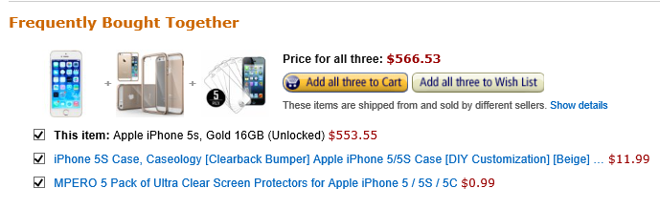
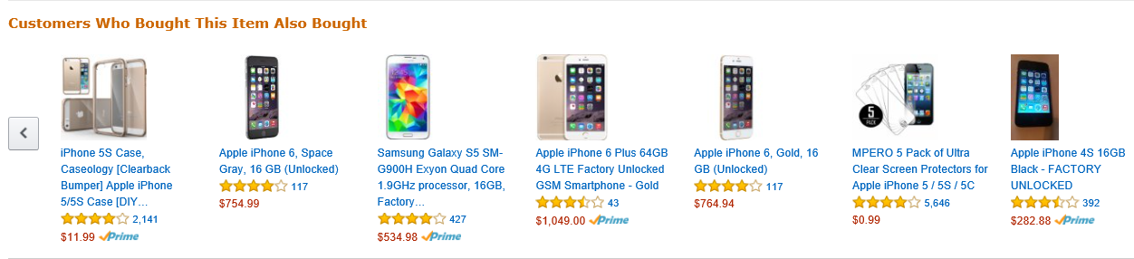
This is the Concept you wont find in YELP a popular application.
Amazon uses this data mining technique to suggest the user and making him to buy more products.
This implementation helps to learn how can a mahine Can think and recommend in a best way like a human. This is Machine learning

Slide 26
Thank You !
Any Questions ?

